Slide 1
Community detection via random walk
Draft slides

Slide 2
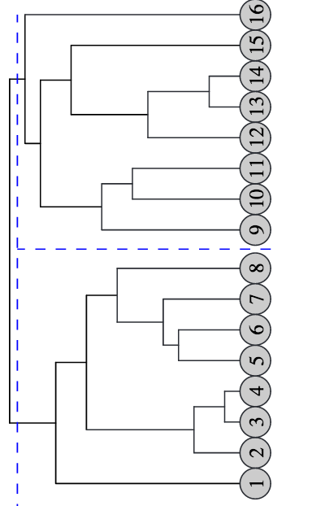
Background
H
Consider a social graph G=(V, E), where |V|= n and |E|= m
Girvan and Newman’s algorithm for community detection runs in O(m²n) time, and O(n²) space.
The Walktrap algorithm by Pons et al. computes a community structure (dendogram) in O(mnH) time, where H is the height of the dendogram – more scalable. The worst case is O(m²n) time.

Slide 3
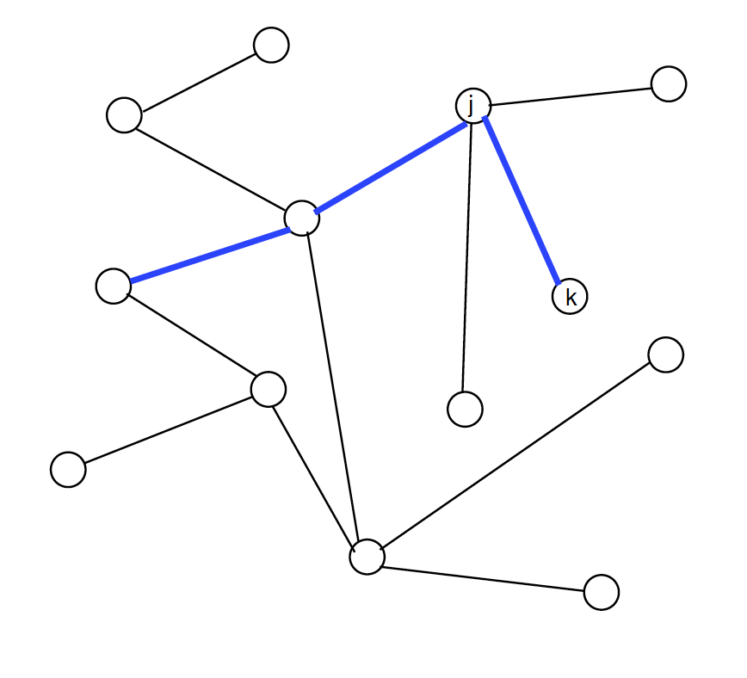
Random walk
= probability that a random walk from j reaches
a neighbor k, where A is the graph matrix (0-1)
The probability of going from
i to j through a random walk of
length t is

Slide 4
Random Walk
If two vertices are in the same community, the probability then will surely be high.
But the fact that is high does not necessarily imply that are in the same community.

Slide 5
Ward’s agglomerative clustering
Well known statistical method that estimates the distance
between two clusters C1 and C2 (see Wikipedia). Walktrap
uses this idea, but defines its own measure of distance based
on random walk and probability.

Slide 6
Random Walk
Intuition behind Walktrap
Random walkers tend to get ‘trapped’ into densely connected parts (communities).
Establish a distance measure between
vertices (and between clusters) based on P^{t}

Slide 7
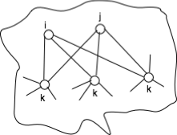
Distance between nodes
Let be two vertices of the graph. Pons et al. defined distance
where is the probability of reaching j from through a random walk of length t
High degree nodes trap
most random walks

Slide 8
Distance between two communities
Consider the probability that a random walk from a random vertex in community C to reach a vertex in steps. Call it
Then the distance between two communities
is

Slide 9
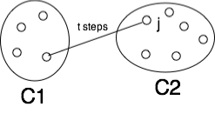
Distance between two communities

Slide 10
The Algorithm
Initially there is one partition
In each step, choose two communities
(based on the distance between them)
and create a new partition
Where is the new community
Update the distance between them.

Slide 11
Communities to merge
This choice plays a central role in the quality of the community detection. At each step k, merge two communities that minimize the mean of the squared distance between them
NP-hard for a given k
Can be reduced to the
K—median problem
L

Slide 12
Conclusion
Walktrap (Pons et al.) has been implemented in iGraph Library

